Slide 1
WIDER VALUES
Focus Group
Methodology
Links to materials in appendix

Slide 2
Drill of the workshop and facilitation
Purpose of the session
  Explore wider values prioritized on the site
  Support dialogue across different perspectives to understand how different stakeholders see a particular land use scenario
  Learn from suggested practices and discuss alternative spatial strategies based on broader values ​​of soil remediation and restoration
Interactive & participatory format
  Duration of 1.5 hour
  Recommended to have 3-6 people per group
  Hands-on game using cards, tokens, scales, and tables
  No right or wrong answers, focus on discussion
Facilitator role
  Guide discussions by asking questions, not influence decisions
  Ensure balanced participation and timing
  At the start of Step 2, present two (land use) scenarios linked to the site.
Key mindset
  Be open, creative, and collaborative
  Embrace trade-offs and different viewpoints

Slide 3
Game steps
01

Slide 4
Wider values focus group
Participants will be divided into two groups: Group 1 with xx and Group 2 with xx
Indicator-based prioritization: General importance, not specific to a scenario
Scenario co-creation: Design your future land
Ethical perspective: Diving into specific land scenarios
Pitch your scenario

Slide 5
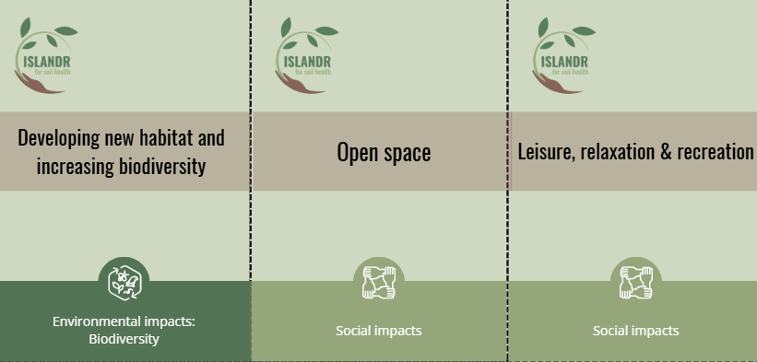
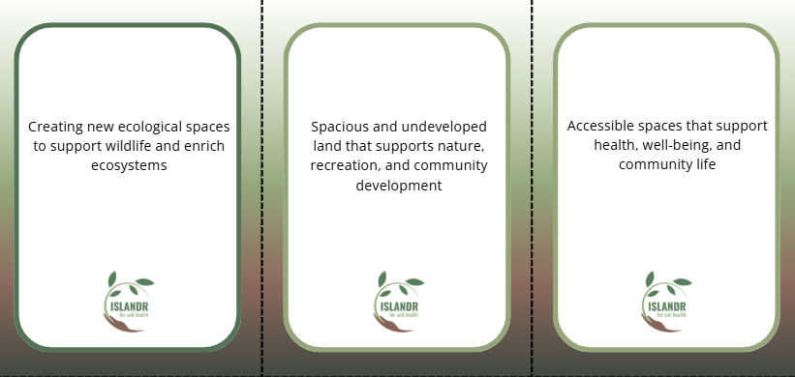
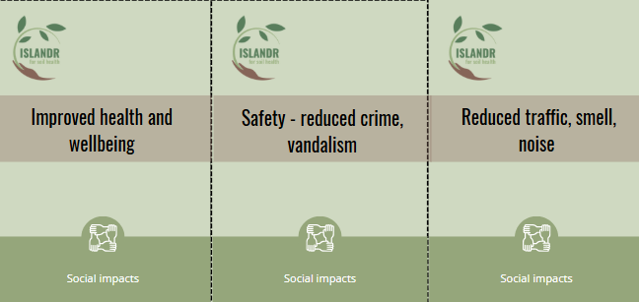
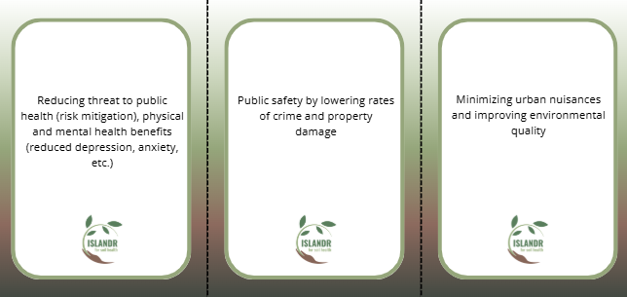
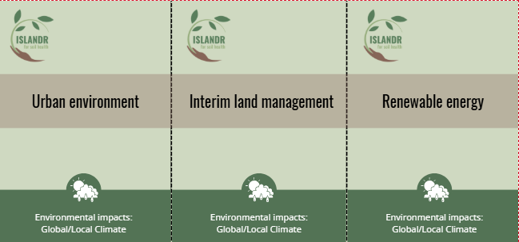
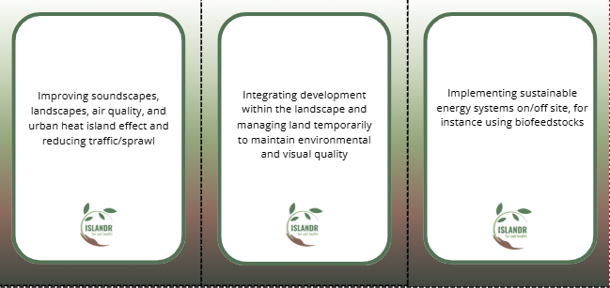
Indicators to assess wider values
List of categories
Environmental impacts | Local/Global Climate
 | Soil and soil health
 | Water
 | Biodiversity
Social impacts | Social impacts
Economic impacts | Directly to specific stakeholders
 | For the wider society
Categories of the indicators / ISLANDR’s or yours
Indicator cards with descriptions
You can use the cards format and adapt it from Canvas

Slide 6
Step 1: High priority indicators
Indicator-based prioritization building on the pre-session survey
⏱️ Estimated time: 30 minutes
Materials needed
Indicator cards (front: Title and Category / back: Description)
The facilitators introduce the indicator categories, the cards, and the prioritization scale. Each group receives a set of indicator cards and a scale. Distribute the cards evenly among participants in each group.
1
Taking turns, each participant reads their card and its description. The group then discusses their perceptions on each indicator and collectively places cards on the scale based on general importance, not yet tied to specific scenarios.
2
3
Each group selects 10 high-priority indicators considered most relevant to their region.
Scale
Not relevant
Low priority
Medium priority
High priority

Slide 7
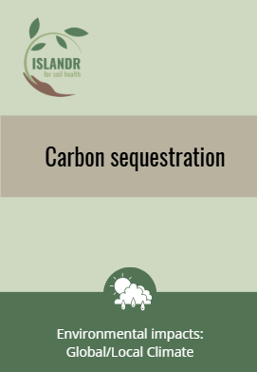
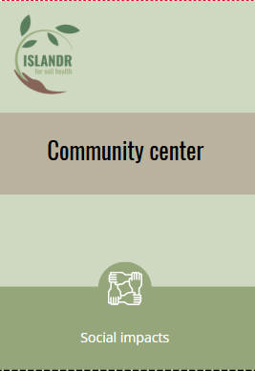
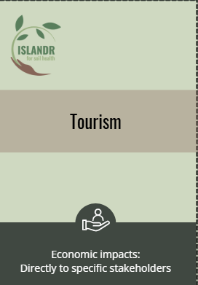
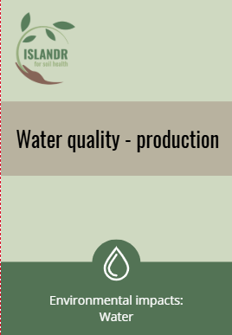
Step 1: High priority indicators
Ranking indicators using the scale
Not relevant
Low priority
Medium priority
High priority
This issue does not apply to our community or has no real impact locally. It is nota consideration for us.
This issue is of limited concern locally. It may be relevant elsewhere but is not a pressing need in our area.
This issue is somewhat relevant in our local context. It is not urgent, but it still matters and could bring added value.
This issue is a major concern in our community or territory. It relates directly to pressing local needs, challenges, or problems.
Example of indicators ranked on the scale

Slide 8



Step 2: Value orientation
Five potential ethical perspectives to guide decision-making
Nature
Valuing unity with and protecting nature, caring for all living things
Nature protection
Ecological health
Environmental responsibility
Community
Valuing equality, social justice and caring for other humans
Community well-being
Fairness
Health
Intergenerational justice
Governance
Economy
Valuing wealth, achievement, status and economic influence; caring about environmental issues if perceived as a threat to or opportunity for oneself
Individual benefits
Economic opportunities
Jobs
Income
Stability
Valuing safety and
security, tradition, loyalty and social stability
Continuity
Safety
Tradition
Innovation
Valuing independence, self- direction and stimulation
Openness to change
Transformation
New solutions
Notes:
Introduce value orientations / start by high level five values as reasons behind the decision making

Slide 9
Spatial planning strategies / Scenarios
These spatial planning strategies present differentiated objectives, actions and land uses as possible alternatives for the future of the xx sites:
SPS1
SPS2
xx
xx

Slide 10
Step 2: Value orientation
Diving into land use scenarios and values behind the high-priority indicators selection
⏱️ Estimated time: 20 minutes
Materials needed
Indicator cards
Front: Title and Category
Back: Description
Pens
Each participant chooses their top two ranked indicators from Step 1 specific to the land use scenario and ask themselves the following questions :
Which value orientation they reflect
Why does this matter to you? Any personal experience?
How would you feel if you had to compromise it?
1
2
Collectively, fill the table in, one row per indicator for top 10 indicators.
Table (example in the next slide)
Indicator | Value Orientation | Value Conflict | How would you feel if you had to compromise this indicator?
3
Debrief in a group about the decision-making process.

Slide 11
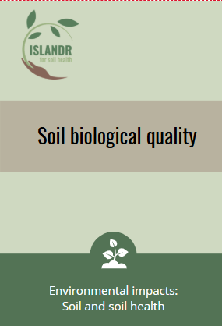
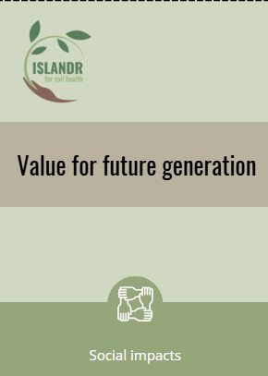
Step 2: Value orientation (Example)
Diving into land use scenarios and values behind the high-priority indicators selection
Indicator description | Value orientation | Value conflict ? | How would you feel if you had to compromise this indicator?
Soil biological quality: Including soil fertility, describing the ability of the soil to supply nutrients | N | N versus E
Value for future generation: Heritage, option, and bequest values of this ecosystem, referring to historical significance and preserving it for future generations | C & N | C versus E & I | I would feel unfortunate and sorry for my children not to be able to grow up with this surrounding and its meaning as the ancestors worked a lot on this land to make it what it is today.
Tourism: Attracting tourism to support local economy (e.g. "little Alps" in Wallonia) | E | E versus N
Example of table filled out with the high-priority indicators

Slide 12


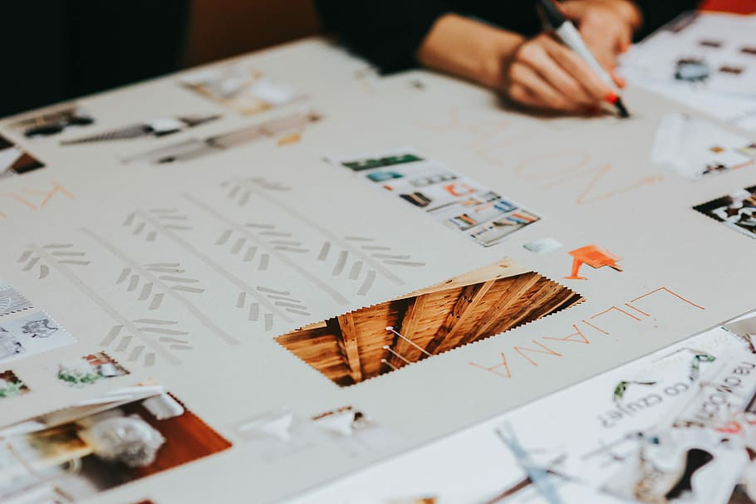
Step 3: Design your future (land)
What does our land look like in 2035 ?
⏱️ Estimated time: 20 minutes
Materials needed
Tokens of community and stakeholders + blank tokens
Large paper
Pen
Each group keeps the same scenario from the two land use scenarios from Step 2.
The participants will stand up to proceed the Step 3.
1
Discuss the scenario by reflecting on following questions:
1. What does our land look like in 2035, considering the political or financial limitation, and what kind of value or benefits would this land use bring ?
2. Who is affected by this change and how ?
2
Use a large sheet and the tokens to create a vision board. Place the tokens on the roadmap and draw connections to show synergies, dependencies, or trade-offs if relevant. Participants are free to draw or decorate the board and can create additional stakeholder or community tokens using the blank ones if they feel a relevant element is missing.
3

Slide 13
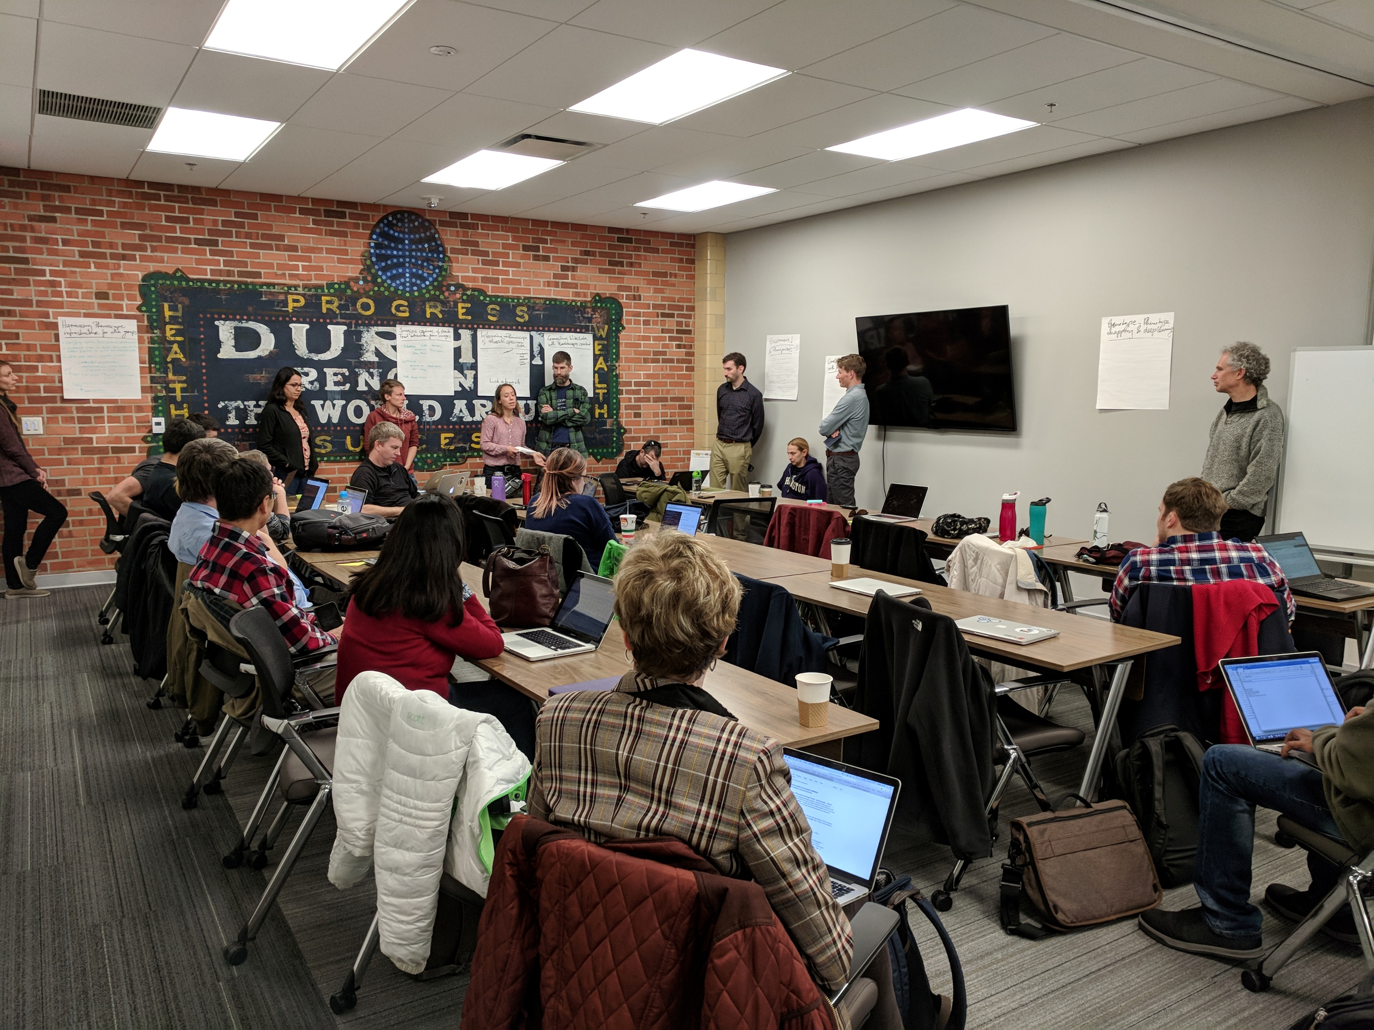
Pitch and Debrief
In 2035, our (land) will look like …
⏱️ Estimated time: 20 minutes
Each group will present their final scenario in a 10-minute pitch, including:
Scenario name and vision
Top 10 indicators (Step 1 and Step 2)
A brief walkthrough of the vision board and key connections
This Photo by Unknown Author is licensed under CC BY

Slide 17
Appendix
02

Slide 18
Materials to download
Indicator cards + tokens
  Editable: https://www.canva.com/design/DAGtyLJQSzg/_BQ8IllwdC7G5mdDobFFZw/edit?utm_content=DAGtyLJQSzg&utm_campaign=designshare&utm_medium=link2&utm_source=sharebutton
  Original version: https://www.canva.com/design/DAHEZiyczA8/sWpAGAb3uPLU8whUOmP1uw/edit?utm_content=DAHEZiyczA8&utm_campaign=designshare&utm_medium=link2&utm_source=sharebutton
Indicator cards + tokens (Printable version with reversed back page)
  Editable: https://www.canva.com/design/DAG0cLanlsk/SLyXXpJ9JOb4iZ4dyk83DA/edit?utm_content=DAG0cLanlsk&utm_campaign=designshare&utm_medium=link2&utm_source=sharebutton
  Original version: https://www.canva.com/design/DAHEZvJS7eA/gAzSIEh8k0vegjqWFc9Psw/edit?utm_content=DAHEZvJS7eA&utm_campaign=designshare&utm_medium=link2&utm_source=sharebutton
Scale : https://www.canva.com/design/DAHEZriU26Y/RJKAfVkKVsVhGQNta17Gaw/edit?utm_content=DAHEZriU26Y&utm_campaign=designshare&utm_medium=link2&utm_source=sharebutton

Slide 19
Indicators 1/4
General impacts | Description
Human Health Protection | Reducing exposure to environmental risks, supporting physical and mental health
Protection of Ecology | Preserving ecosystems and environmental characteristics
Environmental impacts : Local/Global Climate | Description
Urban environment | Improving soundscapes, landscapes, air quality, and urban heat island effect and reducing traffic/sprawl
Framing Built Developments, Interim land management | Integrating development within the landscape and managing land temporarily to maintain environmental and visual quality
Renewable energy | Implementing sustainable energy systems on/off site, for instance using biofeedstocks
Air emissions (GHG, pollution), spills and leakage for soil and water | Addressing harmful emissions and contamination risks that affect air, soil, and water quality
Carbon sequestration | Capturing and storing carbon in vegetation and soil
Greenfield development savings (i.e., not developing greenfield land), and /or reusing infrastructure as positive benefits from redeveloping brownfield | Redeveloping used land reduces sprawl, preserves nature, and makes efficient use of existing infrastructure

Slide 20
Indicators 2/4
Environmental Impacts: Soil and soil health | Description
Soil protection | Protecting soil from contamination, erosion, salinisation and other threats
Soil quality and fertility | Enhancing nutrients, functionality, crop, vegetative cover, grazing etc.
Green infrastructure | Vegetative covers, connecting to cities and urban environment, biodiversity corridors
Environmental Impacts: Water | Description
Water Quality - production | Supply of (treated) water for on-site uses; Provision of Potable Water Resource; Improving quality of surface water on site or in the vicinity; Leachate treatment and reuse (Landfill, Acid Mine, etc.)
Water Protection - regulation | Rain / drainage water (including sustainable drainage); Groundwater Treatment and Protection; Retention of runoff / Surface Water Storage
Environmental impacts: Biodiversity | Description
Protection of habitat and biodiversity (where existing and for protected sites) | Safeguarding natural areas and species from harm or loss due to development
Developing new habitat and increasing biodiversity | Creating new ecological spaces to support wildlife and enrich ecosystems

Slide 21
Indicators 3/4
Social impacts | Description
Open Space | Spacious and undeveloped land that supports nature, recreation, and community development
Leisure, Relaxation & Recreation | Accessible spaces that support health, well-being, and community life
Accessibility | Footpaths and cycle routes
Views and viewpoints, Improved recreation and amenity on site and in surroundings (tourism), Aesthetic value, Land value, Symbolic value | Enhancing visual appeal, recreational use, and cultural or symbolic meaning, contributing to tourism and land value
Education | Learning and development; Creativity & innovation, adding the educational value
Community Centre | Enabling volunteering and community engagement
Addressing historical neglect in underprivileged areas | Enhancing community identity and pride through revitalized neighborhoods, ownership, empowerment, etc.; Environmental justice
Social impacts | Description
Sense of place (and pride) | Local identity and community pride through meaningful and well-integrated spaces
Improved health and wellbeing | Reducing threat to public health (risk mitigation), physical and mental health benefits (reduced depression, anxiety, etc.)
Safety - reduced crime, vandalism | Public safety by lowering rates of crime and property damage
Reduced traffic, smell, noise | Minimizing urban nuisances and improving environmental quality
Policy & Governance | Contribution to local community engagement, inclusion in decision-making - partnerships between public and private stakeholders
Heritage / Option value / bequest | No direct benefit but there could be in the future, or stakeholder value this ecosystem and want to preserve it

Slide 22
Indicators 4/4
Economic impacts: directly to specific stakeholders | Description
Real estate markets and regeneration (Land value recovery over time, Area value uplift) ; increased in land value of the site | Redeveloping to increase site value and spurs long-term area-wide economic uplift
Leverage of additional investment | Attracting public and private partnership (PPP) or local investment
Improvement of local taxation revenues, payment schemes, regulations, others to attract investment | Boosting investment (private and public) through targeted tax incentives, payment schemes, regulations
Revenue generated from renewable energy | Providing financial return from renewable energy sources on-site
Tourism | Attracting tourism to support local businesses
Economic impacts: for the wider society | Description
Job generation, Urban renewal and entrepreneurship, generate local business revenue, stimulus to local economy | Stimulating the local economy through inclusive and innovative employment
Real estate markets and regeneration : increased in property value in the surroundings | Increasing property value through area regeneration (land value recovery over time, Area value uplift) and environmental improvements

Slide 23
Tokens for the game
Tokens for communities |  | Tokens for stakeholders
School | Bus stop | Kids | Local business owners
Parking lot | Market / Grocery store | Birds | Students
Park | Recycling center | Pollinators (e.g., bees, butterflies) | Fish / Aquatic species
Shopping mall | Police station | Water | Domesticated animals
Hospital | Pedestrian road | Trees | Emergency services (firefighters, medics, police)
River | Restaurant | Tourists | Farmers
Bike lane | Hotel | Microorganisms (e.g., soil bacteria, fungi) | Civil servants
Playground | Kinder garden | Elderly people
Sports field / gym

